Slide 1
Session 28
Federal Benefits Pre-Retirement Counseling and Benefits Update
Sonny Barber, USDA/ARS/AFM
Kaela Black, Iowa State University
Keith Niemann, University of Nebraska - Lincoln
Celia Rainville, University of Vermont
Mary Fran San Soucie, Montana State University

Slide 2
Changes--Appointment of Extension Directors/Admin
No longer require USDA approval
Continue to notify the NIFA Office of the Director when new Extension Director/Administrator is appointed.
  Ramaswamy, Sonny sonny@nifa.usda.gov
The State Extension Service Directors and Administrators Directory address@lyris.nifa.usda.gov

Slide 3
Benefits for Lesbian, Gay, Bisexual, and Transgender (LGBT) Former Schedule A Employees and Annuitants
Federal employees and annuitants, regardless of their sex, can now legally marry in any state in the United States of America, including their state of residence.
Qualifying Life Event (QLE) Window of Opportunity: 31 days before the marriage to 60 days after.

Slide 4
LGBT Benefits--Retirement
Eligibility requirements for providing a survivor annuity are the same for everyone, regardless of gender.
In order for your spouse to maintain Federal Employees Health benefits as a survivor, you must
  Provide a survivor annuity to your spouse
  Meet the eligibility requirements to continue FEHB into retirement
  Be enrolled in a self and family or self+1 plan on the date of death

Slide 5
LGBT Benefits--Domestic Partnership
Same-sex couples who are in a civil union or other forms of domestic partnership other than marriage will remain ineligible for most Federal benefits programs.

Slide 6
LGBT Benefits--Detailed Information
Detailed information on Benefits for LGBT Former Schedule A Employees and Annuitants is available at
https://www.opm.gov/policy-data-oversight/diversity-and-inclusion/reference-materials/
https://www.youtube.com/watch?v=t0As-ESLdsA&feature=youtu.be
https://www.opm.gov/policy-data-oversight/diversity-and-inclusion/reference-materials/benefits-for-lgbt-federal-employees-and-annuitants-supplemental-resource-to-webcast.pdf

Slide 7
LGBT Benefits--FEHB
Employees and annuitants under the FEHB Program may make an enrollment change to Self Plus One or to Self and Family based on a marriage.
You may also change from one plan or option to another. The QLE determines what type of enrollment change is permitted. The enrollment change must be consistent with the QLE.

Slide 8
Federal Employees Health Benefits (FEHB)--CLER
OPM Federal Employees Health Benefits Centralized Enrollment Clearinghouse
Submit each pay period

Slide 9
FEHB Self Plus One Enrollment
Effective Date: January 1, 2016
Forms were updated to include new plans
May require modifications to payroll systems
OPM FAQs - http://www.opm.gov/healthcare-insurance/special-initiatives/self-plus-one/

Slide 10

New Tax Forms for FEHB Enrollees:
Forms 1095-B and 1095-C

Slide 11
Internal Revenue Code (IRC)
Sections 6055 and 6056
Added by the Affordable Care Act
IRC Section 6055
  Requires health coverage providers, including FEHB plan providers, that offer minimal essential coverage to file information returns with the Internal Revenue Service (IRS) and provide statements to all enrollees about their health coverage.
IRC Section 6056
  Requires employers, including Federal agencies, to file information returns to the IRS and provide statements to their full-time employees about the health insurance coverage the employer offered.

Slide 12
IRC Section 6055 Reporting Requirements: Health Coverage Provider Reporting
  FEHB plan providers (health insurance carriers) must report on all enrollees
  Coverage information for every individual
    SSNs for individuals and dependents
    Employer Identification Number (EIN) of employer
  Annually beginning with 2015 plan year
  IRS and individuals will use the information to administer or show compliance with the individual shared responsibility provisions of the Affordable Care Act
    Carriers must furnish individual statements by March 31, 2016
    Carriers must file information returns to IRS by May 31, 2016 or if electronic by June 30, 2016.

Slide 13
IRC Section 6056 Reporting Requirements:
Employer Reporting
  Federal agencies or their designated payroll provider must report on health insurance coverage offered to employees
  Report to employees: employers must furnish IRS Form 1095-C to their full-time employees
  Contains information about health insurance coverage offered by the employer
  Employers must furnish employee statements by March 31, 2016
    Internal Revenue Service (IRS) Notice 2016-4 extended due dates
    Many agencies and Shared Service Centers have started
  Must be furnished on paper by mail unless consent for electronic from employee

Slide 14
IRS Forms 1095-B and 1095-C
Form 1095-B (FEHB Plan Provider)
Provides information needed to report on your income tax return that you, your spouse (if you file a joint return), and individuals you claim as dependents had qualifying health coverage for some or all months during the year.
Form 1095-C (From Employing agency)
Includes information about the health insurance coverage offered to you by your employer.

Slide 15
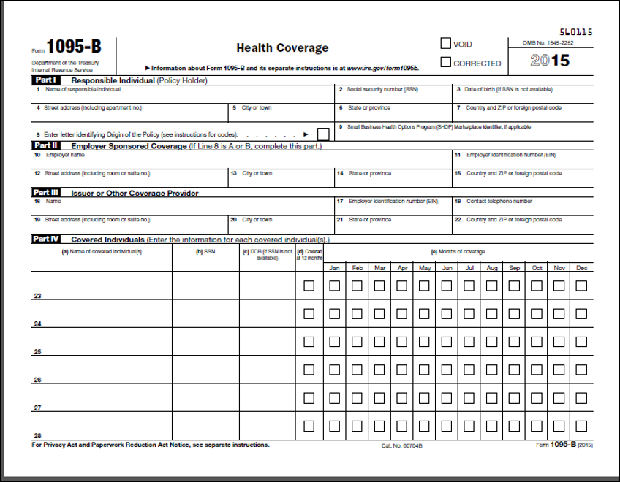
IRS Form 1095-B

Slide 16
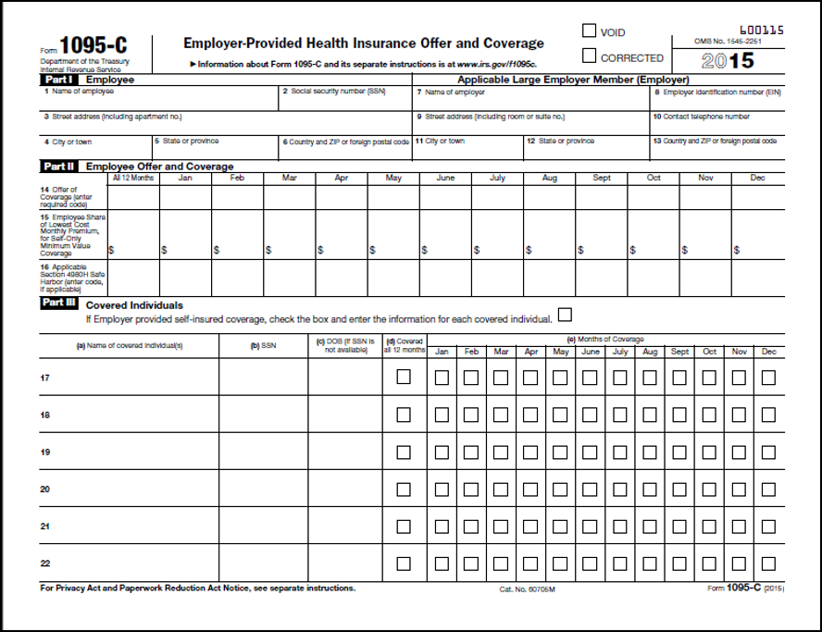
IRS Form 1095-C

Slide 17
IRS Form 1095-B Corrections
Inquiries and Form Corrections
  It is the FEHB plan provider’s responsibility to make corrections to, and answer questions about, the IRS Form 1095-B.
  Employees should contact their FEHB Plan providers directly.
Contact on Line 18
  This should include the FEHB plan provider’s contact information.
Dependent Information
  Enrollees should contact their FEHB plan provider about missing dependent information.
  If you are a retiree and your spouse is enrolled in Medicare, your Medicare covered spouse will not be included since Medicare is the primary payer.

Slide 18
IRS Form 1095-C Corrections
Inquiries and Form Corrections
  It is the agency’s responsibility to make corrections to and answer questions about the IRS Form 1095-C.
  OPM does not have employee data to answer questions about the information on this form.
Contact on Line 10
  An individual at the agency, such as Human Resources, Benefits Officer, or Payroll staff, that can answer questions about employee information should be listed.
Dependent Information
  Agencies are not required to list dependents on the IRS Form 1095-C. Employees may receive dependent information from their FEHB plan provider, but not from their employer.

Slide 19
Guidance and Resources
OPM Guidance
  www.opm.gov/ESR
  BALs
    BAL 16-203: Employee Information on Health Coverage; AIR Testing (includes FastFacts for Employees)
    BAL 15-204: Mandatory Reporting Requirements under IRC 6056 and 4980H
    BAL 14-212: Designation to SSC to file reports
    BAL 15-202: Employer Resources
  FAQs and FEHB Carrier Communication
IRS Information Reporting
  http://www.irs.gov/Affordable-Care-Act/Employers/Information-Reporting-by-Applicable-Large-Employers
Questions and Answers about Health Care Information Forms for Individuals
  https://www.irs.gov/Affordable-Care-Act/Questions-and-Answers-about-Health-Care-Information-Forms- for-Individuals

Slide 20
Medicare—Encourage Part B Participation
Medicare eligible annuitants should enroll in Medicare Part B. (age 65)

Slide 21
Federal Employee’s Group Life Insurance
Premiums changed January 1, 2016
No changes to the premium rates for Basic Insurance for employees.
Most premium rates for Option A, B, and C will decrease.
Premium rates for Post-Retirement Basic Insurance with 50% Reduction and No Reduction will increase.
Premium rates for older age bands of Options B and C will increase.
Rates on BAL 2015-203

Slide 22
FEGLI
Enroll or increase coverage by providing satisfactory evidence of medical insurability (SF 2822) – usually open season
Cancel or reduce coverage (SF 2817)
Change beneficiaries (SF 2823)
Employees must contact their human resources office to take FEGLI actions

Slide 23
FEGLI
You can also elect or increase FEGLI coverage within 60 days after a FEGLI life event (SF 2817)
  Marriage
  Divorce
  Death of spouse
  Acquisition of an eligible child

Slide 24
LGBT Benefits--FEGLI
Marriage is a qualifying life event for FEGLI, allowing eligible employees to enroll in FEGLI or increase their coverage outside of a life insurance open season.
With the FEGLI life event, an eligible employee can elect up to the maximum coverage offered by the program: Basic insurance, Option A, five multiples of Option B, and five multiples of Option C.

Slide 25
FEGLI Beneficiaries
Can name any beneficiary(ies) you choose, including a trust
Can change beneficiaries at any time
To change beneficiaries, submit SF 2823
Periodically remind employees to keep beneficiaries current and where to submit the form

Slide 26
LGBT Benefits--FEGLI Beneficiary
If you have FEGLI coverage and die without a valid designation of beneficiary on file with your employing agency, then the FEGLI coverage on your life will be paid according to the order of precedence provided by law.
Same-sex spouses are recognized in the order of precedence in the same manner for FEGLI benefits as different-sex spouses. Assuming you die with no designation, no court order on file with your agency, and you haven’t assigned

Slide 27
LGBT Benefits--FEGLI Beneficiary
  Same-sex spouses are recognized in the order of precedence in the same manner for FEGLI benefits as different-sex spouses.
    Assuming you die with no designation, no court order on file with your agency, and
    you haven’t assigned your coverage to a third party, then the order of precedence would pay your FEGLI life insurance benefits to your surviving spouse, same-sex or opposite-sex, if you have one.

Slide 28

FEGLI Life Insurance Open Season
From Sept 1, 2016 through Sept 30, 2016
FEGLI-eligible employees can elect or increase any coverage FEGLI offers, including Option C (Family Coverage)
No medical exam and no health questions

Slide 29

FEGLI Life Insurance Open Season Coverage Effective Date
One year delayed effective date
Open Season was From Sept 1, 2016 through Sept 30, 2016
Effective first day of the first full pay period on or after
  October 1, 2017
Mitigates the risk of adverse selection
No premiums due until coverage is effective
  The five year rule still applies. If new enrollment, to keep
    coverage employee must retire after Oct 2022.

Slide 30

FEGLI Life Insurance Open Season Election Method
No special Open Season election form
Employees will use SF 2817 or its electronic
  equivalent
In Box #6, input Event Code 6 for an
  Open Season election
Return a copy of the election to the
  employee as proof of receipt
Agency will hold election until October 2017

Slide 31

FEGLI Life Insurance Open Season No Mandatory Action
No affirmative election required
If employee does nothing during the FEGLI Open Season, employee will keep the same FEGLI enrollment he/she has now

Slide 32
FEGLI Life Insurance Open Season Additional Guidance
More Open Season BALs on the way
  Answers to frequently asked questions
  Sample emails
  Web resources
  Data reporting
Subscribe to BenefitsInfo listserv by going to listserv.opm.gov and clicking on “Email Lists”

Slide 33

FEGLI Life Insurance Open Season General FEGLI Guidance
Resources at www.opm.gov/life
  Life Insurance Overview flyer
  Your FEGLI Life Insurance videos
    Employee version
    Annuitant and retiring employee version
    Schedule a screening for your employees!
  FEGLI Handbook
  All FEGLI BALs and Open Season materials

Slide 34
Payroll—Retirement Rates
CSRS
  Employee – 7% Agency Contribution – 7%
FERS
  Employee – .8% Agency Contribution – 13.7%
CSRS Offset
  Employee – .8% Agency Contribution – 7%
Former Schedule A employees do not qualify for FERS-RAE

Slide 35
Base Pay for Retirement
It is the amount of pay scheduled to be earned by an employee (before the addition of any allowance, adjustment, or differential) for the unit of work assigned to the Extension position which is officially recorded in a position description that described the duties and responsibilities in order to accomplish a specific Extension job.
Basic pay is normally fixed by law or regulation. Pay increases may be granted based upon legislation, other regulatory provisions or legal orders.

Slide 36
Base Pay for Retirement
Excluded from basic pay are bonuses, allowances, overtime, holiday, and military pay.
Outside consulting and other outside contractual agreements/arrangements are not included either, as these items fall outside and are in addition to the day-to-day set of duties and responsibilities of the encumbered Extension position.

Slide 37
Base Pay for Retirement
Federal retirement contributions are authorized to be taken only from an employee’s basic pay and not necessarily from the pay actually received by the employee.
An employee's basic pay is the only pay amount authorized to be included on the Individual Retirement Record.
It is also basic pay that is used to compute an employee’s high-3 average pay for retirement purposes.

Slide 38
Payroll--Reporting
Report of Withholdings and Contributions (2812 and 2812A)
Use Revised October 2014 version
Includes section for FERS-FRAE

Slide 39
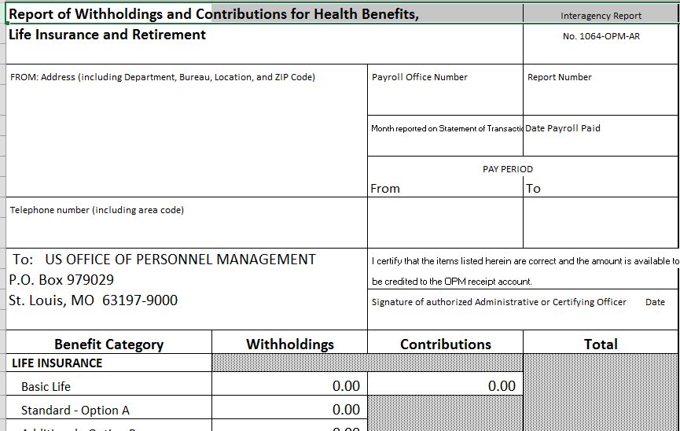

Slide 40
Individual Retirement Record
CSRS SF 2806
FERS SF 3100
Excel version of SF 2806 and SF 3100

Slide 41
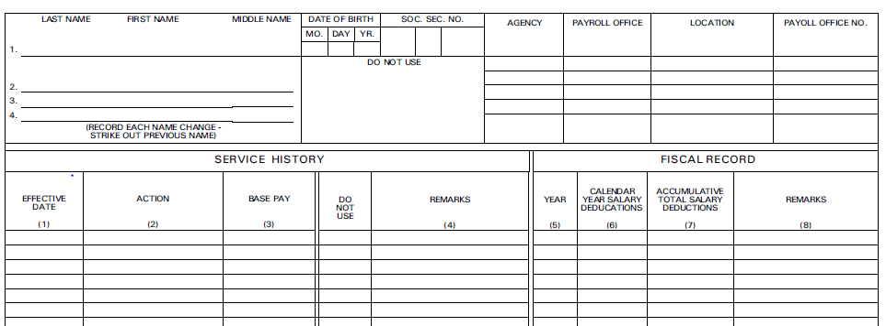

Slide 42
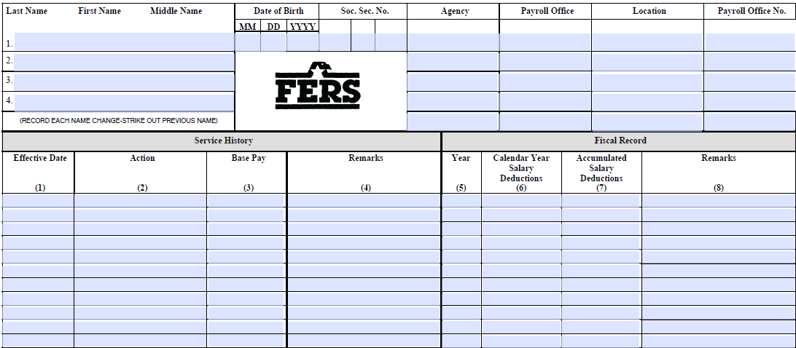

Slide 43
Sick Leave
Unused sick leave is not transferable to:
  Another Cooperative Extension Service Agency
  Another federal agency

Slide 44
Former Schedule A Appointment Types
9-Month or other cyclic work schedules not permissible
Must remain formally employed in a CES organization
Continue to spend at least 50% of their time on Extension functions

Slide 45
Former Schedule A Appointment Types
Continuous on a permanent basis and throughout the entire year
Make full-time (2080/2087 hours) annual contributions to the Federal retirement fund
Can have up to 6 months of leave without pay in a calendar year without impacting retirement

Slide 46
Phased Retirement
USDA has announced a pilot program for phased retirement for the Research, Education, and Economics mission area
REE has approval for this pilot until January 6, 2018
CES employees with Federal benefits are not eligible to participate in this pilot program

Slide 47
Retire / Rehire
Requires a 4 or more calendar days break in service
Rehired on a state appointment with applicable state policies

Slide 48
Types of Federal Retirements
Optional Retirement – CSRS and FERS
Early Voluntary Retirement
Discontinued Service Retirement

Slide 49
Voluntary Early Retirement Authority (VERA)
The authority encourages more voluntary separations and helps the agency complete organizational change with minimal disruption to the work force
All VERA requests must be in the format of the OPM template for VERA requests
Request must be submitted to USDA for submission to OPM (new person)

Slide 50
Voluntary Early Retirement Authority (VERA)--Fees
In 2013 OPM started charging fees for processing VERA applications.
Payment is only required if agency has a VERA application in that year. BAL 16-301

Slide 51
Discontinued Service Retirement (DSR)
A discontinued service or involuntary retirement provides an immediate annuity to eligible employees who are separated due to management action
DSR is approved by USDA/ARS/AFM (new person)
Contact new person to discuss requirements and to obtain a copy of the DSR publication

Slide 52
Office of Personnel Management BAL (Benefits Administration Letter) #17-101
Subject: Additional Guidance on Military Deposits
Replaces BAL 13-103
What this BAL does:
  Provides a general discussion of what constitutes an administrative error related to a military service credit deposit.
  Reminds Human Resource Specialists of the necessity of counselling employees about paying military deposits
  Notifies Human Resource Specialists of the procedures that must be followed
  Provides links to and an analysis of several decisions that have impacted the treatment of military deposits

Slide 53
Retirement Application
Submit when you can certify the Individual Retirement Record (IRR) at the end of appointment
Use most recent application from OPM web site
Include a copy of the marriage certificate or proof of common law marriage

Slide 54
OPM Backlog
As of 4/6/17:
OPM saw 7,216 new retirement claims filed in March. The agency processed 10,602 claims last month, almost 28 percent more than it was able to process in February.
OPM received nearly 1,500 more claims in March 2017 than it did in March 2016.
With the uptick in claims processed, OPM drove down its claims backlog by more than 14 percent in March, although the backlog remains nearly 7 percent higher than it was in March 2016. At 20,530 claims, the backlog stays above OPM’s steady-state benchmark of 13,000 claims.

Slide 55
Common Errors in Retirement Applications
Tips for Submitting a Healthy Retirement Application
  http://www.opm.gov/retirement-services/benefits-officers-center/webcast-presentations/tips-for-healthy-retirement-applications.pdf
My Federal Retirement
  http://www.myfederalretirement.com/public/1070.cfm

Slide 56
Common Errors—Retirement Application
Former spouse question not answered
Missing marriage certificate
Annuitant did not make survivor election (including unmarried applications)
Spouse information missing for married applicants, including separated

Slide 57
Common Errors—Spousal Consent (2801-2 and 3107-2)
Not signed
Not notarized
Notary commission expired
Not notarized on same date spouse signed
No white out, corrections or alterations

Slide 58
Common Errors—FEHB
Proof of 5 years coverage, would prefer coverage for entire career (2809/2810)
FEHB code on IRR does not match transferred enrollment forms
Need copy of Medicare card

Slide 59
Common Errors—FEGLI
Proof of 5 years coverage—Life Insurance Election (2817/176)
Agency Certification (2821)
  Missing, not signed, coverage does not match 2817, alpha codes does not match IRR
Continuation of Life Insurance (2818)
  Missing, not signed, elected coverage exceeds permitted coverage – with no white out or corrections

Slide 60
Common Errors—Military Service
Missing Character of Service on DD214 (Member Copy—4)
Post 56 IRR not marked paid in full
Missing documentation verifying if the retiree is receiving Military Retired Pay and the correct reason on why they are receiving it

Slide 61
Thrift Savings Plan Contribution Limits for 2017
Elective Deferral Limit $18,000
  Applies to combined total of traditional and Roth contributions.
Catch-Up Contribution Limit $6,000
  For participants age 50 and older

Slide 62
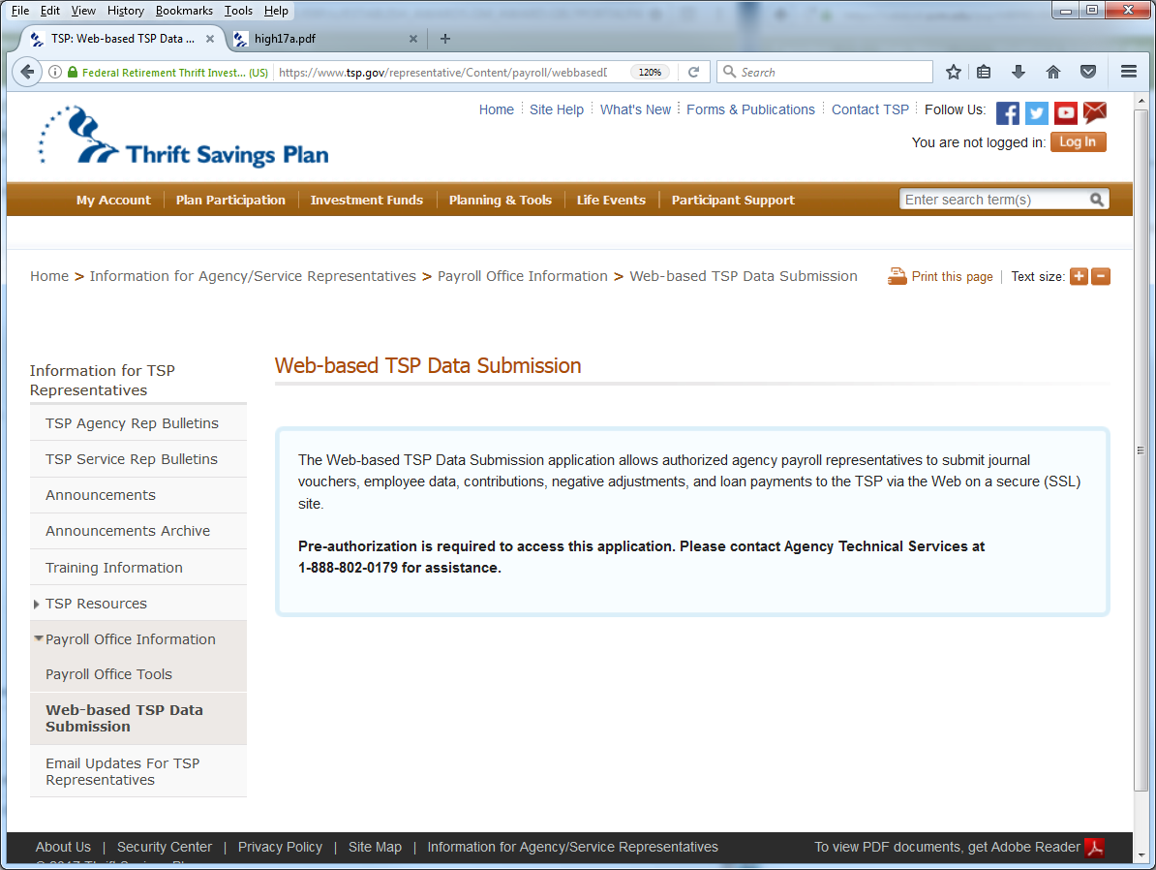

Slide 63
FEGLI Address
FEGLI Claims and Regular Mail:
OFEGLI
P.O. Box 6080
Scranton, PA 18505-6080

Slide 64
FEGLI Address
Overnight (Express Mail):
OFEGLI
10 Ed Preate Drive
Moosic, PA 18507
Fax Number: 1-570-558-8659
Source: BAL 15-201 - http://www.opm.gov/retirement-services/publications-forms/benefits-administration-letters/2015/15-201.pdf

Slide 65
Mailing Address for Retirement Packets
OPM, Employee Service & Records Center
PO Box 45
Boyers, PA 16017

Slide 66
Mailing Address for Federal Folders
After retirement/separation mail Federal Folders to:
National Archives & Records Administration (Annex)
1411 Boulder Boulevard
Valmeyer, IL 62295
Phone # for FedEx 618-935-3062

Slide 67
Annuitants Should Receive
CSA number 10 days after OPM receives application
PIN soon after CSA number
Retirees receive their first interim payment in 5-7 business days from the date the agency's electronic file or paper records are received by OPM

Slide 68
Retirement Claims Processing
Annuitants do not receive FERS annuity supplement while in interim status
Interim status payments are based on 60% to 80% of agency retirement estimate.
Approximately 80% of new claims are being processed in 60 days or less.

Slide 69
Death of Annuitant
Application for Death Benefits
CSRS http://www.opm.gov/forms/pdf_fill/sf2800.pdf
FERS https://www.opm.gov/forms/pdf_fill/sf3104.pdf
Claim for Death Benefits for FEGLI
  http://www.opm.gov/forms/pdf_fill/fe6.pdf
The Office of Personnel Management at 888-767-6738 or retire@opm.gov
Report the Death of Annuitant at Services Online
  https://www.servicesonline.opm.gov/RSR/AnnuitantDeath

Slide 70
Retirement Services Online
https://www.servicesonline.opm.gov/

Slide 71
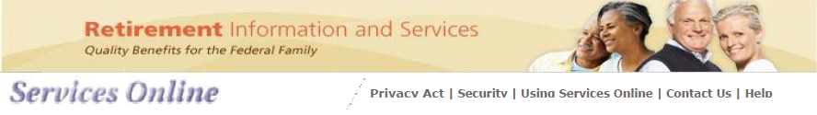
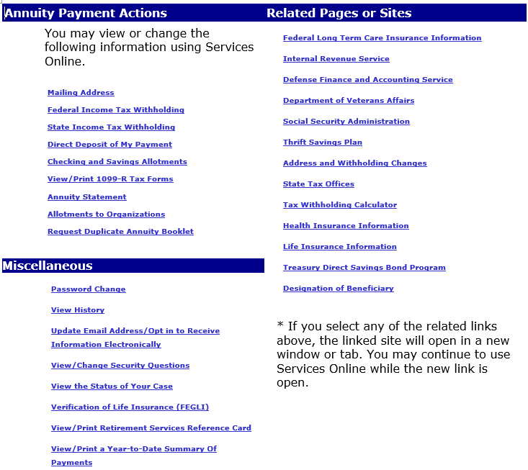

Slide 72
OPM Trainings
OPM continues to conduct training via webcasts
OPM announces webinars and training
    on the benefits list serve
  BENEFITSINFO@LISTSERV.OPM.GOV

Slide 73
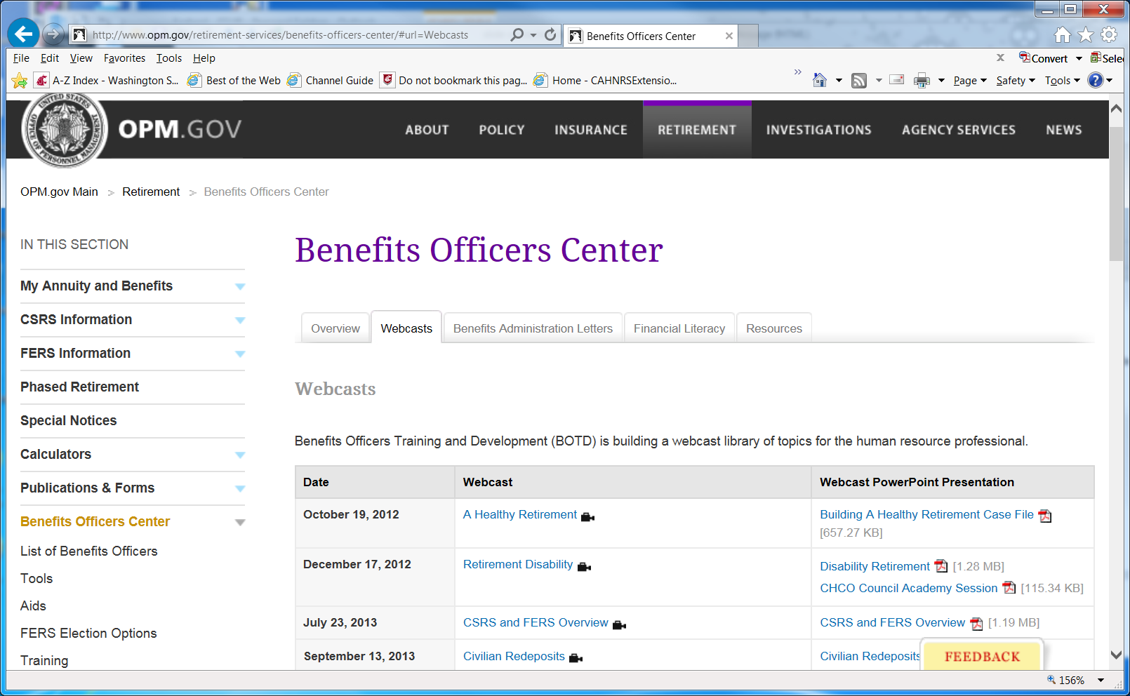
http://www.opm.gov/retirement-services/benefits-officers-center#url=Webcasts

Slide 74
Resources
CES HR List Serve
exhrgroup@listserv.montana.edu
OPM Benefits Administration Letters (BALs) - http://www.opm.gov/retirement-services/publications-forms/benefits-administration-letters/
OPM Forms - http://www.opm.gov/forms/

Slide 75
Resources
Benefits Administration Information
  To subscribe:
    http://apps.opm.gov/Listserv_Apps/list-sub.cfm?CFID=13388481&CFTOKEN=77413557
  Choose Benefitsinfo

Slide 76
Resources
Payroll and Financial Management Guidance
  To subscribe: http://apps.opm.gov/Listserv_Apps/list-sub.cfm?CFID=13388481&CFTOKEN=77413557
  Choose FINPAY

Slide 77
Resources
Office of Personnel Management
Director’s Blog
http://www.opm.gov/blogs/Director/

Slide 78
Resources
Kaela Black, Iowa State University
    515-294-3283 kblack@iastate.edu
Keith Niemann, University of Nebraska - Lincoln
    402-314-7923 keith@unl.edu
Celia Rainville, University of Vermont
    802-656-4003 Celia.Rainville@uvm.edu
Mary Fran San Soucie, Montana State University
    406-994-6648 maryfran@montana.edu
Sonny Barber, USDA/ARS/AFM
    301-504-2396 Sonny.Barber@ars.usda.gov
    Retiring April 30, 2017

Slide 79
Federal Dental Insurance and Vision Insurance (FEDVIP)
Former Schedule A Employees
Are not eligible to enroll as employees

Slide 80
Federal Dental Insurance and Vision Insurance (FEDVIP)
Former Schedule A Employees
Are eligible to enroll as Retirees
  If retired with an immediate annuity
  At open season
  Not a Qualifying Life Event for enrolling, canceling or changing enrollment
  Enroll at https://www.benefeds.com/

Slide 81
Federal Long Term Care Insurance Program
Provides long term care insurance for its enrollees, who are Federal and U.S. Postal Service
Employees
Annuitants
Active and retired members of the uniformed services,
Their qualified relatives

Slide 82
Federal Long Term Care Insurance Program
Eligibility—
All CES employees with Federal benefits
Agency does not have to participate in Federal Employees Health Benefits Program

Slide 83
Federal Long Term Care Insurance Program
Agency is responsible for notifying employees.
Agency not required to take deductions.

Slide 84
my Social Security
Online services
  access earnings record
  view benefit estimates
  address and phone change
  start or change direct deposit
  apply for benefits
For more information, go to www.socialsecurity.gov/myaccount

Slide 85
Voluntary Contribution Program
This program allows CSRS employees (FERS employees are not eligible) to contribute up to 10% of their lifetime civil service basic pay (multiples of $25 per contribution) into the VCP.
Then they can turn around after retirement and either request an additional annuity or roll these contributions into a Roth IRA.
Taking a refund allows them to ‘transfer’ taxable interest bearing funds from an account they might have and almost immediately roll those funds into a Roth IRA, which does not produce taxable gains when withdrawn.

Slide 86
Voluntary Contribution Program
The money should remain in the Roth IRA account for 5 years and until the retiree reaches 59 ½.
If these rules are not followed and withdrawals are made before 5 years and/or age 59 ½, a 10% penalty applies and income tax must be paid on the earnings.

Slide 87
Voluntary Contribution Program
Please refer to IRS Pub 590 Individuals Retirement Arrangements for more specific details if needed.
Please note that if the employee should ‘sell’ investments to fund their VCP, a capital gain event may occur in the selling year or years.
Please counsel employees that they should only transfer an amount that they can afford to be without before starting the VCP.

Slide 88
Voluntary Contribution Program
Steps
Employee completes SF2804 and submits to agency personnel office
Agency verifies employment and submits form to OPM
OPM approves application, assigns account # (6 mo.), and sends employee instructions on how to make contributions
Employee/retiree sets up Roth IRA to accept refund
Retiree requests additional annuity or a refund using SF2802 or RI 38-124 & submits to Agency
Agency completes SF2802 or RI 38-124 and sends to OPM
OPM either sets up additional annuity or sends refund

Slide 89
Voluntary Contribution Program
Documents to review before jumping into this program:
Application to Make Voluntary Contributions - SF 2804
  http://www.opm.gov/forms/pdf_fill/sf2804.pdf
OPM form that discusses the VCP
  https://www.opm.gov/forms/pdfimage/ri37-22.pdf
Voluntary Contributions Notice:
  http://www.opm.gov/retirement-services/publications-forms/pamphlets/ri38-125.pdf
IRS Publication 721 (2014), Tax Guide to U.S. Civil Service Retirement Benefits:
  http://www.irs.gov/publications/p721/ar02.html
OPM Voluntary Contributions Program Guidelines – Chapter 31
  https://www.opm.gov/retirement-services/publications-forms/csrsfers-handbook/c031.pdf

Slide 90


Boyers, PA

Slide 91
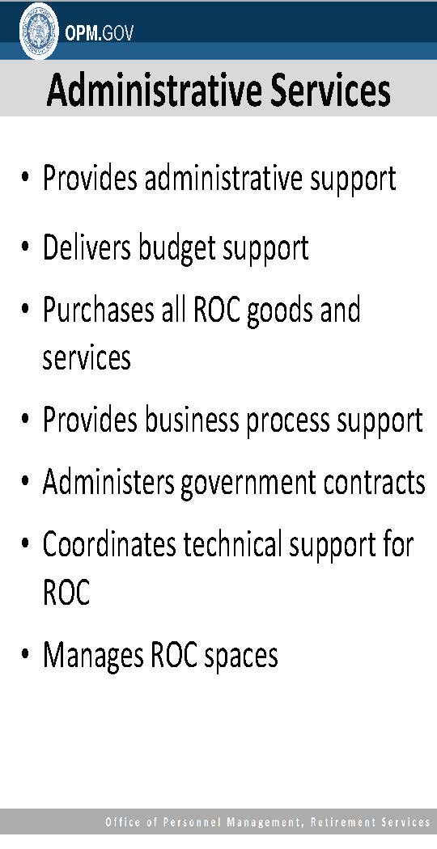

Slide 92
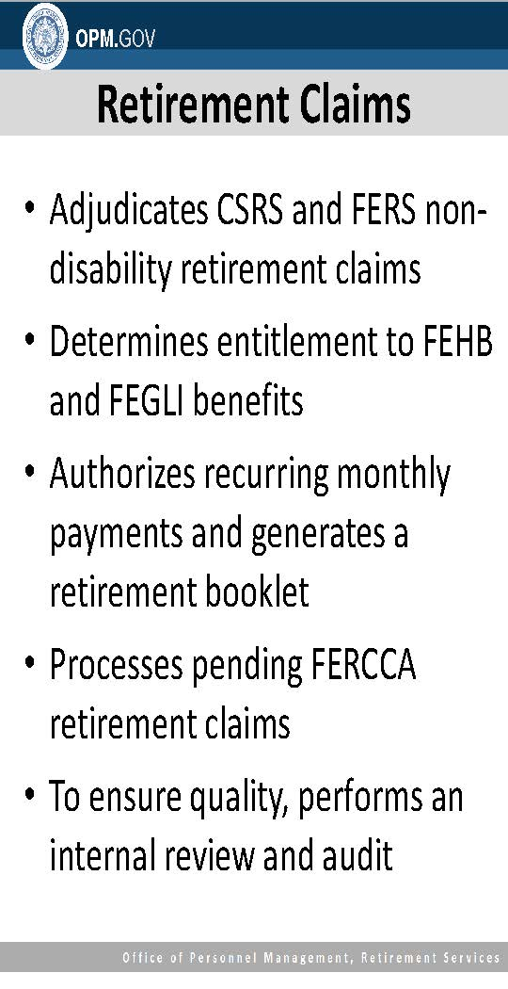

Slide 93
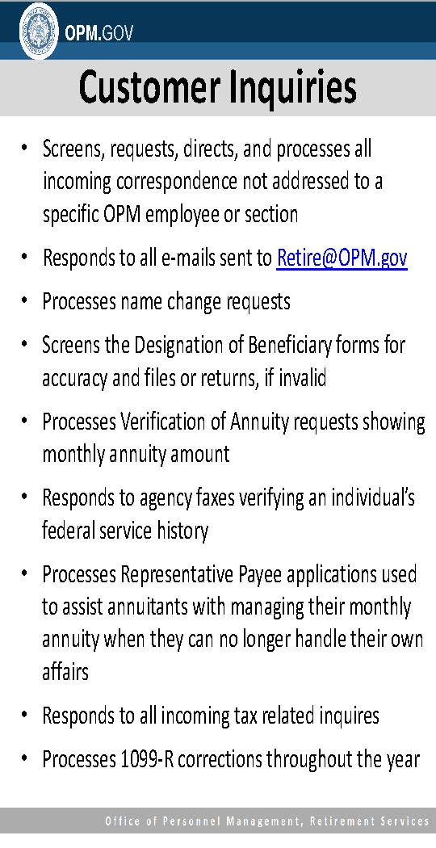

Slide 94
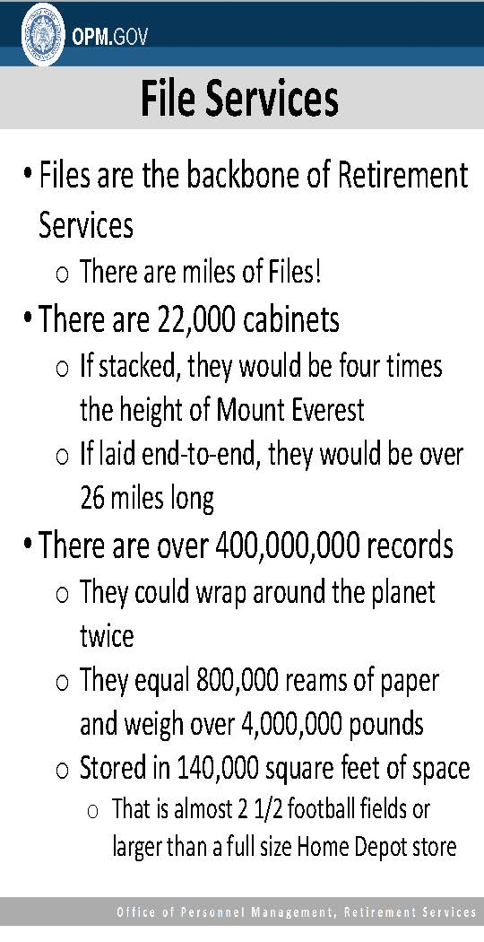

Slide 95
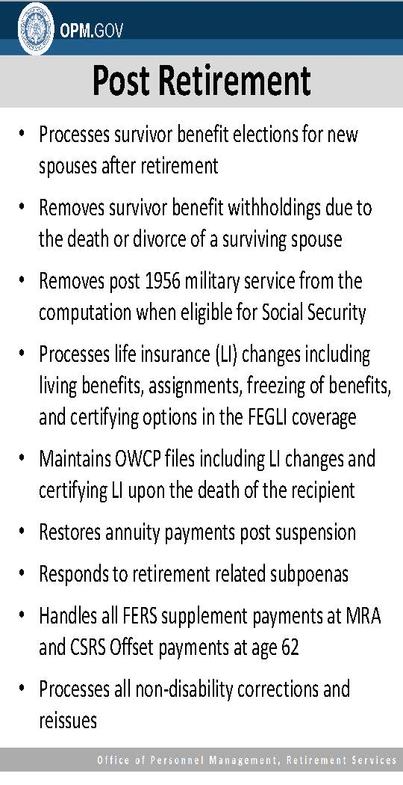

Slide 96
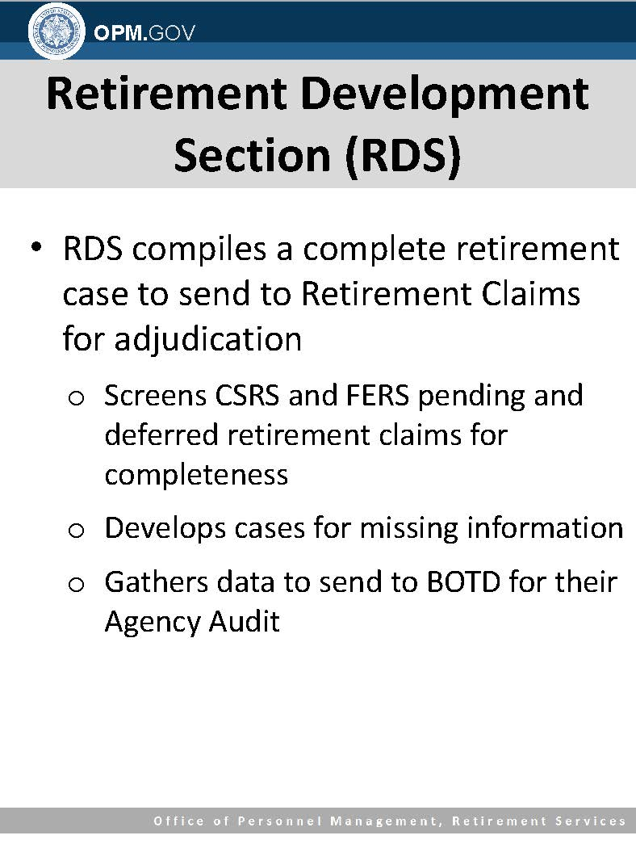

Slide 97
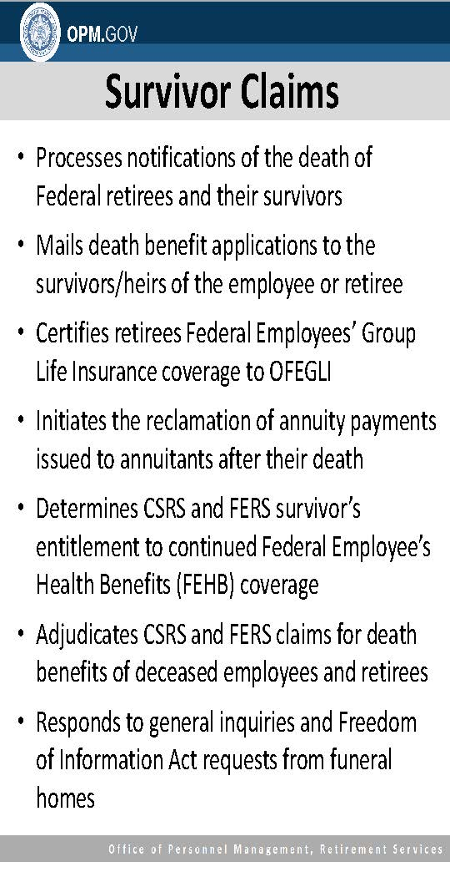

Slide 98
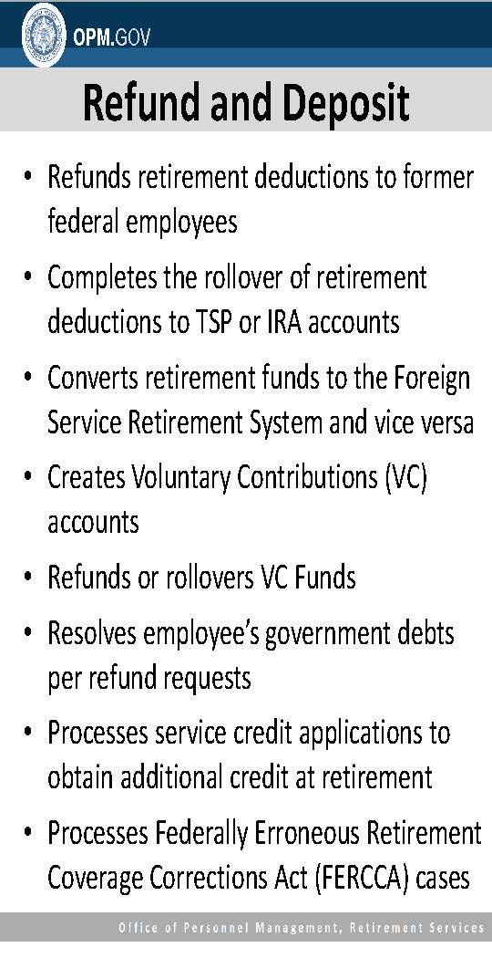

Slide 99
