Slide 1
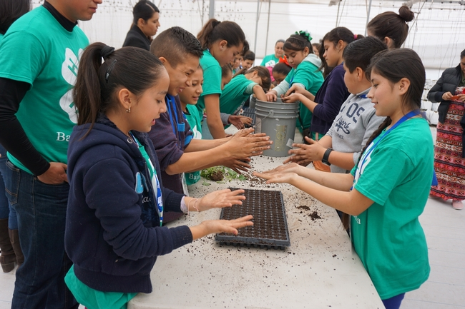
NERAOC 2017
National Extension and Research Administrative Officers
Working with people from other cultures: a challenge or an opportunity?
Facing the new demographic of the United States
Maria G. Fabregas Janeiro, PhD
University of California
Assistant Director for 4-H Diversity and Expansion
NERAOC 2017. San Antonio, TX
April 23-26, 2017

Slide 2
Initial Statement
One of the main challenges (and probably the most important) of the Cooperative Extension Service in the 21st Century is welcoming diversity, foster inclusion and improving personal intercultural competence. Cooperative Extension's survival may depend on our ability to reach minority populations. The challenge is clear, Extension personnel have the responsibility of improving their intercultural competence, developing abilities to effectively work with people from other cultures, and traditional extension structures and clubs MUST change and reflect the culture of the people we serve.
Maria G. Fabregas Janeiro, PhD

Slide 3
Expected Outcome
Discuss key concepts related to Multicultural Environments, Diversity, Inclusion & Intercultural Competence
Discuss the UC ANR Diversity & Inclusion Model
Gain understanding on how to develop a plan to improve your organization and personal Intercultural Competence

Slide 4
Diversity Bingo
Speaks more than one language | Is not a parent | Is of Hispanic/Latino descent | First in family to graduate from college | Is a grandparent
Raised in a working-class household | Was born outside of the United States | Is 50 years of age or younger | A person of Native American Heritage | Is an only child
Has or has had a disability | A person of African descent |  | Is or has been a single parent | Works or has worked with Latino Youth
Cares for an aging parent | Belongs to a church, synagogue, mosque, etc. | Is or knows someone who is lesbian, gay, bisexual, transgender, or queer | Doesn’t have a college degree | Has lived outside of the US
Is bi-racial or multi-racial | Is raising a grandchild | Is single | Works with military families | A person of European ancestry

Slide 5
America by the Numbers
Total population 308,745,538
White | 78%
Black or African American | 13%
American Indian and Alaska Native | 1%
Asian | 5%
Native Hawaian and other Pacific Islanders | 0.2%
Two or more races | 2%
Source: 2010 US Census

Slide 6
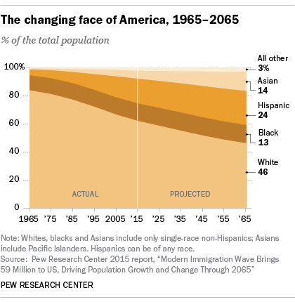

Slide 7
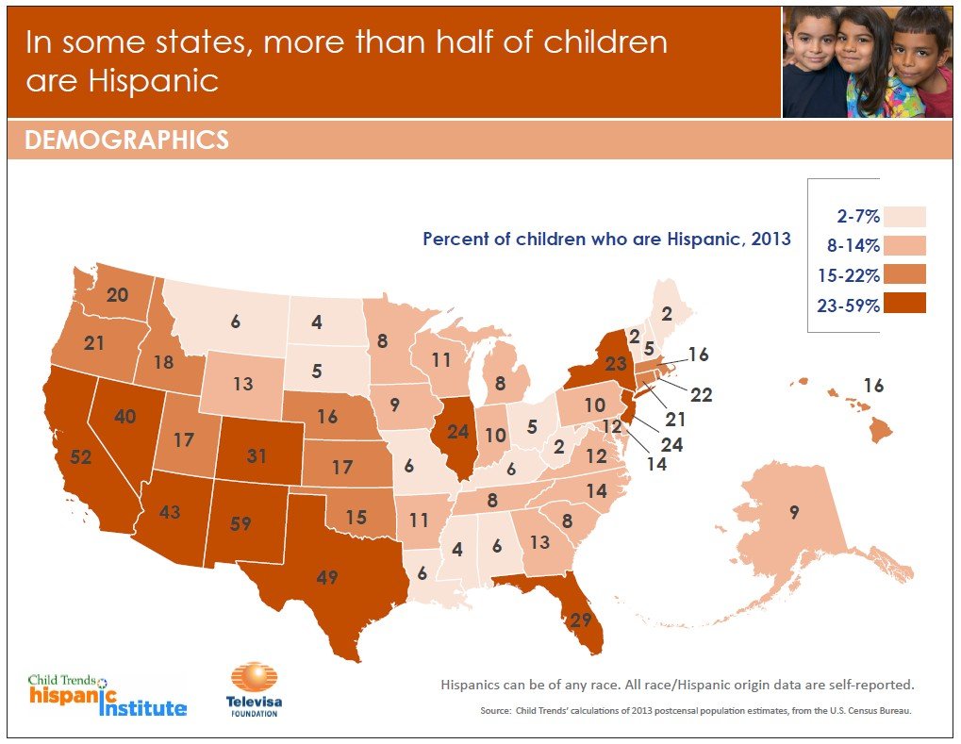
Notes:
California is the number one state with 52% of Latino population.
Latinos represent 17% of the total population in the United States
From 2000 to 2010 the growth rate of Latinos in the United States was 47% (compare with 9.7% of the total population)
Latino Youth (under 18) accounted for 24.4% of the total population in the United States and projections indicate that they will make up more than 38% by 2060

Slide 8
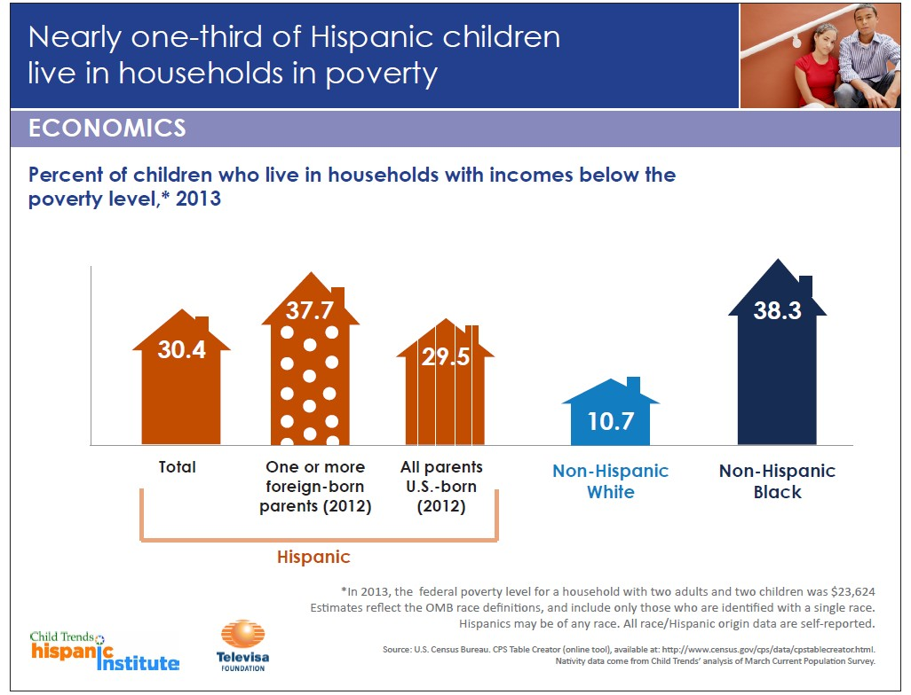
Notes:
In 2014, the poverty rate for Latinos in the Unites States was 23.6% (compare with 14.8% of the total population)
In 2014, Latinos had one of the highest rates of unemployment in the nation (around 7%)
DeNavas-Walt & Proctor, 2015
U.S. Department of Labor, 2016

Slide 9

Latinos represents 51%
percent of all
K-12 Students in California
Pew Research Center, 2011
http://www.pewhispanic.org/states/state/ca/

Slide 10
California…
is the state with biggest disparities among population groups
Latinos will contribute about 80% of the growth in the labor force from 2010 to 2050
U.S. Census Bureau, 2015
Ennis, Ríos-Vargas, & Albert, 2011
Toossi, 2012

Slide 11
Diversity
Multicultural
Environment
Inclusion & Belonging
Intercultural
Competence
Adapted from the material discussed in the IDI statewide conference – February 2017
Notes:
Greater capacity to connect with stakeholders & clientele
Attract and retain more diverse talent
More positive work experience
Greater capacity to navigate and effectively bridge cultural differences to create more equitable policies and practices

Slide 12
Let’s Start with Some Definitions
Culture is who we are!
Socially transmitted behaviors!
Beliefs, costumes, arts, language, ways of life and thinking, behaving, geographic location, etc.

Slide 13
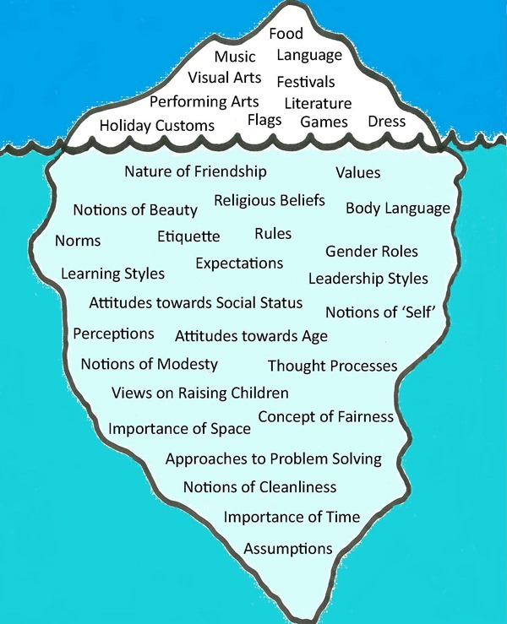
Culture is an Iceberg
Image source: James Penstone, http://opengecko.com/interculturalism/visualising-the-iceberg-model-of-culture/
Notes:
Fe

Slide 14
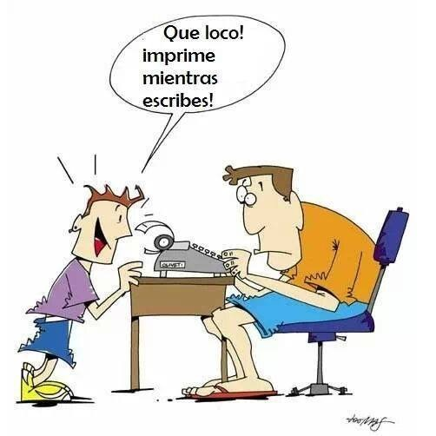
What is a Multicultural Environment (ME)?
ME includes people from different gender, age, race, ethnicity, economic status, sexual orientation, country of origin, language, nationality, or physical/mental ability.
It also includes people from different generations, levels of education, etc.
It is crazy! It prints while you are writing

Slide 15
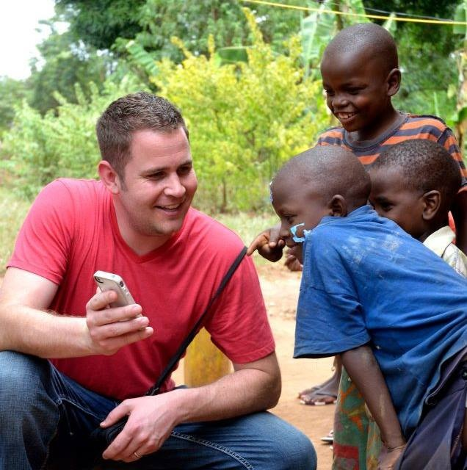
And Access to Technology

Slide 16
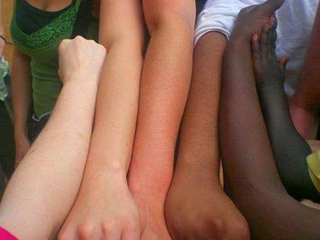
Being in a Multicultural Environment is not the same as knowing how to work in a Diverse Society

Slide 17
Diversity
“Knowing how to relate to those qualities and conditions that are different from our own and outside the groups to which we belong”
Iowa State University. College of Liberal Arts, ¶ 7
17

Slide 18
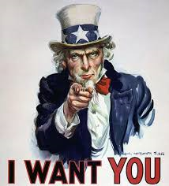
Inclusion & Belonging
To feel comfortable interacting with people from other cultures.
To make people from other cultures feel comfortable when you are working with them.
18
Notes:
Greater capacity to connect with stakeholders & clientele
Attract and retain more diverse talent
More positive work experience

Slide 19
Belonging…..
“Belonging is more than tolerance, acceptance, or inclusion. Belonging means we feel connected, important, value, part of the group, it is our group, our program our community”.
Bengu Erguner-Tekinalp, Ph.D. (April 2016 YSP Meeting – 4-H Iowa).

Slide 20
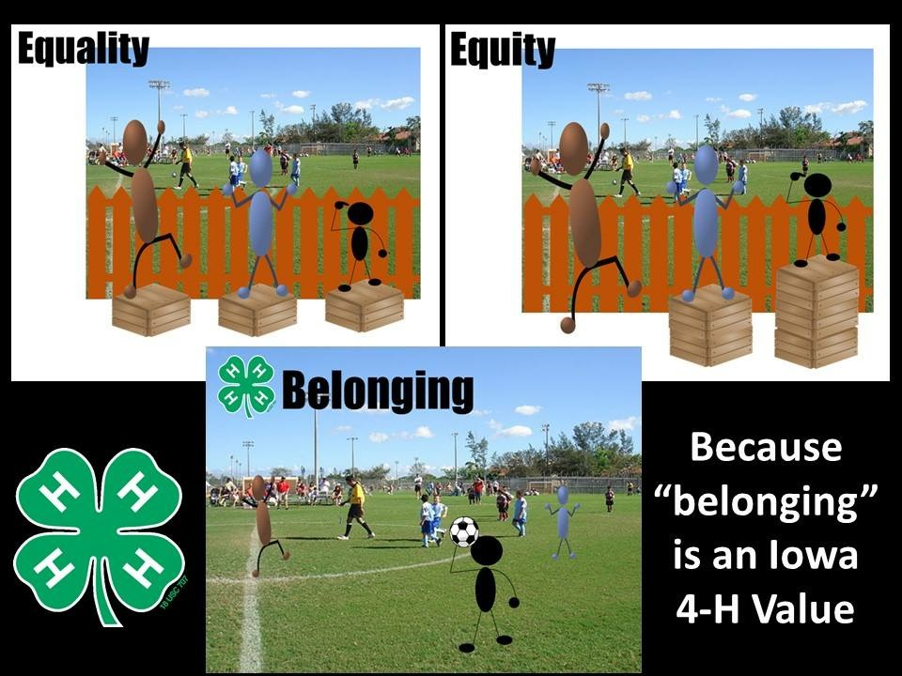
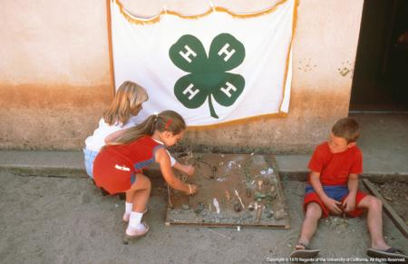

Slide 21
California

Slide 22
Be aware that we are different!!!!

Slide 23
But…find a way to work together!!!!

Slide 24
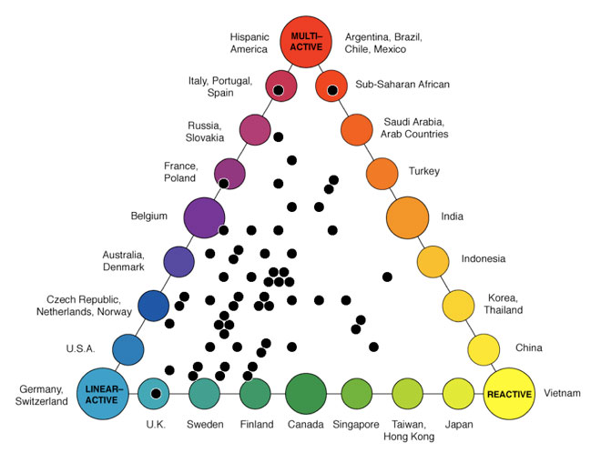
The Lewis Model of Culture
http://www.crossculture.com/latest-news/the-lewis-model-dimensions-of-behaviour/

Slide 25
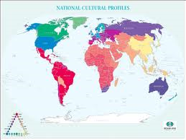
How different we are!
Talks most of the time
Talks half of the time
Does several things at once
Does one thing at a time
Plans grand outline only
Plans ahead step by step

Slide 26
How different we are!
People-oriented
Job-oriented
Feelings before facts
Sticks to the facts
Mixes the social and professional
Separates the social and professional

Slide 27
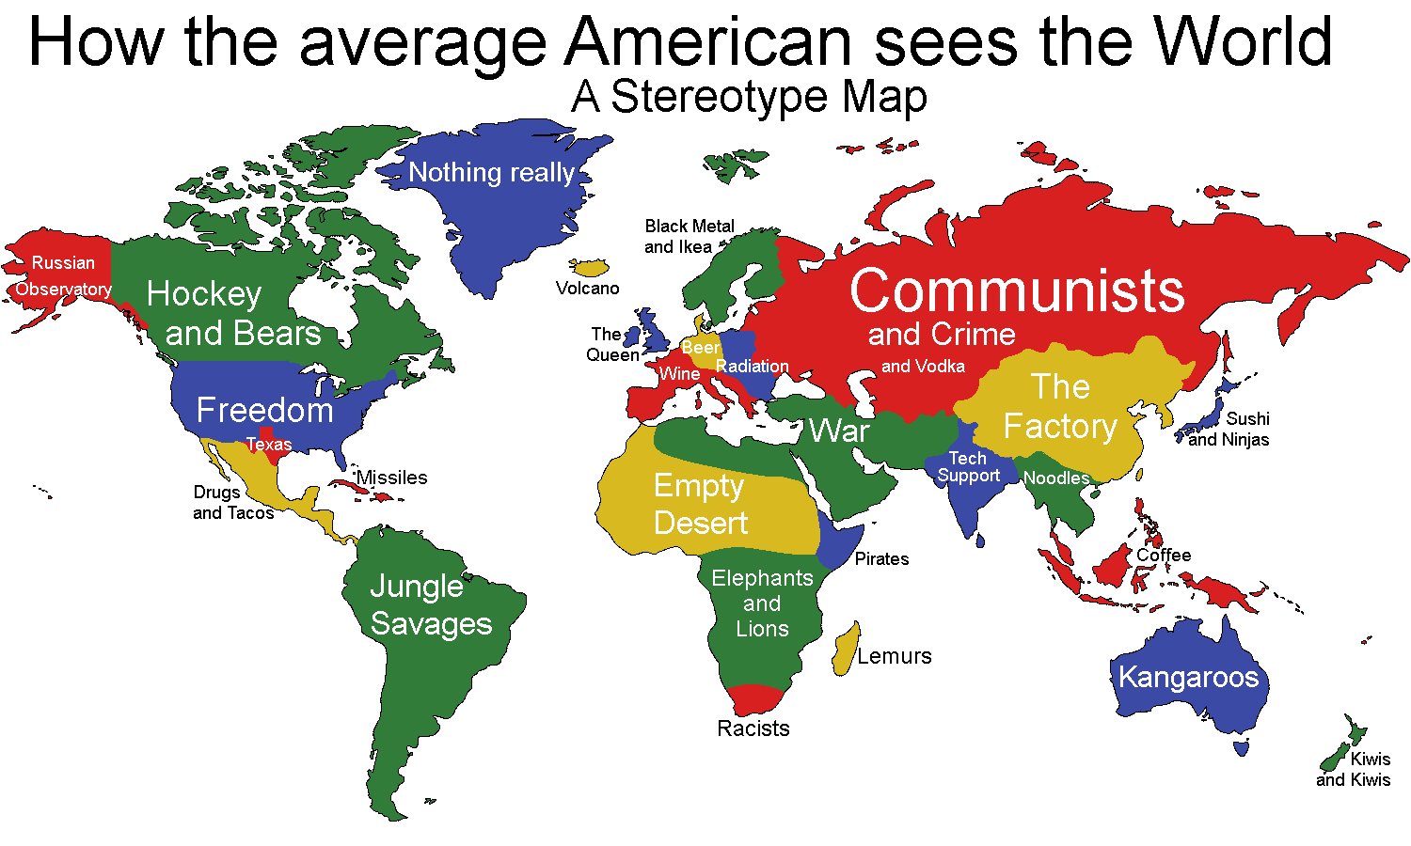
https://www.google.com/search?q=how+the+average+american+sees+the+world&espv=2&biw=1920&bih=979&tbm=isch&imgil=qlASmOZ933uAzM%253A%253BEGU7VH2lZKUzMM%253Bhttp%25253A%25252F%25252Frealfunny.net%25252Fpicture-5235-how-the-average-american-sees-the-world-.html&source=iu&pf=m&fir=qlASmOZ933uAzM%253A%252CEGU7VH2lZKUzMM%252C_&usg=__CqTQ0IY5Lp198H8KHDR7w0GgQHQ%3D&ved=0ahUKEwjNjI_y_ZPOAhUE2IMKHRqVDE8QyjcINQ&ei=c9aYV42HHoSwjwSaqrL4BA#imgrc=qlASmOZ933uAzM%3A

Slide 28
Going back to the original question….
Working with people from other cultures IS a challenge AND an opportunity

Slide 29
Why is it so HARD?
The United States is geographically isolated and this makes many Americans think that being Culturally Competent is unnecessary.
Becoming Culturally Competent is a process that is NOT NATURAL but can be learned.
Berthoin & Friedman, 2008; Haeger, 2007; Peterson, 2004; Zhu, 2001

Slide 30
But we need to do it anyway….
How can I approach people from different cultures?
How can I do it without offending them?
How, how, how, how, how…

Slide 31
We can learn to effectively work with people from other cultures……
Source: Deardorf, D. K. (2009), Hammer, M. (2011)

Slide 32
Diversity
Multicultural
Environment
Inclusion & Belonging
Intercultural
Competence
Adapted from the material discussed in the IDI statewide conference – February 2017
Notes:
Greater capacity to connect with stakeholders & clientele
Attract and retain more diverse talent
More positive work experience
Greater capacity to navigate and effectively bridge cultural differences to create more equitable policies and practices

Slide 33
UC ANR Diversity & Inclusion
Action Plan
Preparing Academics & Staff to better reach and serve new communities in the State of California
Developing/Adapting /Delivering Culturally Responsive Programing to attract and better serve all the communities in the state of California
Facing the Challenge of Embracing Diversity & Inclusion

Slide 34
Prepare Academics & Staff to better reach and serve the Latino communities in the State of California
IDI Qualified Administrators
Diversity Group

Slide 35
IDI Initiative
Assessment & Individual Feedback Sessions
Statewide Conferences
Trainings and Learning Circles

Slide 36
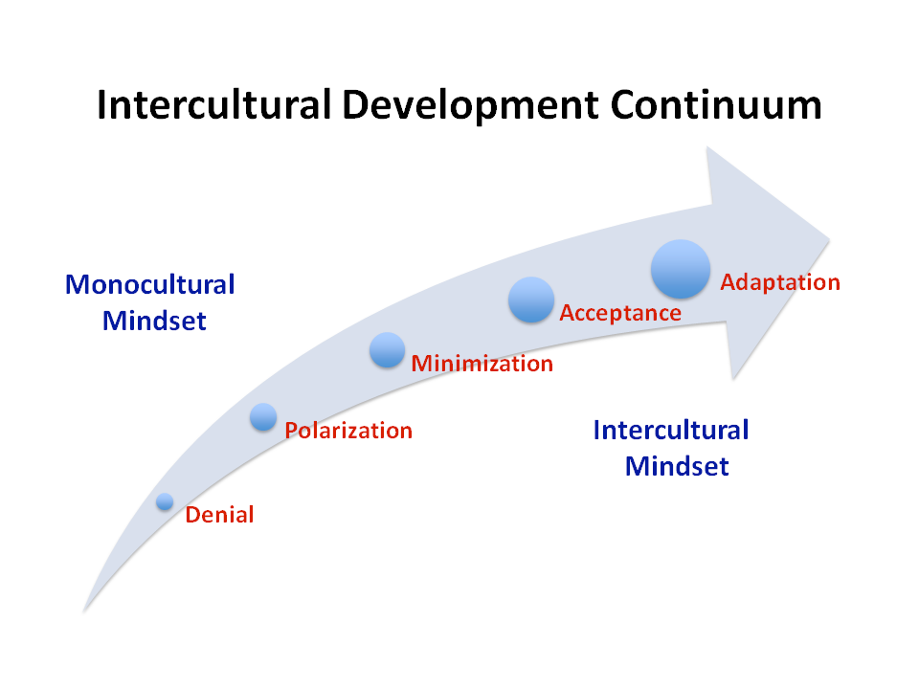
Copyright 2007, 2009 . Mitchell R. Hammer, PhD
15

Slide 37
Summary Orientation Description
Denial
1. I find very small and obvious differences among people. The only thing I notice are people’s gender, age and color.
Polarization
1. I am not like them, and I will never be.
2. I know what is right and what is wrong.
3. I am always right, my culture is “the one”, or your culture is “the one” and mine is wrong.
Adapted from Bennett, 1986, 1993

Slide 38
Summary Orientation Description
Minimization
1. I really do not have to do any effort to “fit in”, we are all the same.
2. I discovered I have a lot of things in common with my partner? My son? Americans? Mexicans? My grandma? The people that I work with?
Acceptance
1. I know that we are different. I can make a list of things that we share but also things we don’t share.
2. Even when we are different, I can work with you….lets talk about our cultural differences.
3. I accept you the way you are.
Adapted from Bennett, 1986, 1993

Slide 39
Diversity Workgroup
Capacity Building
Marketing & Special Projects
Evaluation

Slide 40
UC ANR Diversity & Inclusion Initiative
Develop/Adapt /Deliver Culturally Responsive Programing to attract and better serve ALL the communities in the state
Develop a
UC ANR Diversity and Inclusion Initiative Model

Slide 41
UC ANR Diversity & Inclusion Initiative
(4-H YDP)
$2,000,000
Assistant Director for 4-H Diversity and Expansion
Marketing Coordinator
7 Program Reps

Slide 42
UC ANR Diversity & Inclusion Initiative
Diagnosis
Training
Implementation
Evaluation
Dissemination

Slide 43
Where are we right now?
Advisors and Program Reps completed two trainings (April & October, 2016)
Diagnosis Phase
1. Get involved with the community. Go back to the ROOTS
2. Develop partnership with other organizations
3. Identify the needs of the California communities.

Slide 44
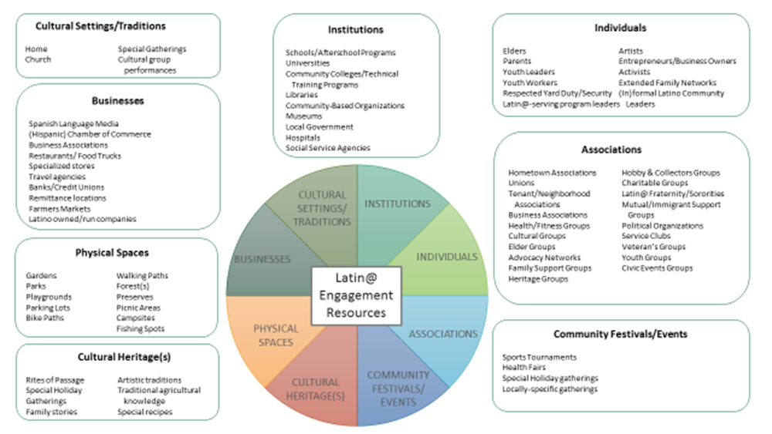
Erbstein, N., Shwartz-Olagundoye, S. & Moncloa, F. (2016). Latino Engagement Resources Chart. Davis, CA: From the Ground Up: Building Foundations for Engaging Latino Youth Populations and Places Training (May 24-25, 2016).

Slide 45
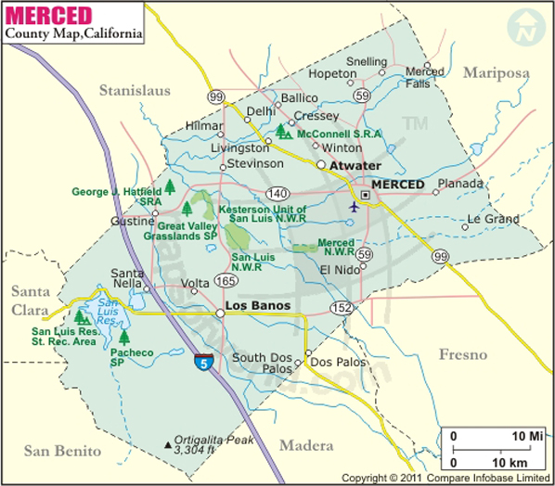
Merced county 4-H
Ballico-Cressey
Snelling
Merced River
Hilmar Colony
McSwain
St. Anthony’s
Westside
Lancer’s 4-H
Bear Creek
Weaver
Forebay
Le Grand
El Nido
Our Lady of Fatima &
Los Baños Community
Dos Palos

Slide 46
Delivering Trainings around the State
Face to Face Meetings (twice a year)
Virtual Monthly Meetings
Cafecitos
Working as Volunteers
Special topic Trainings & Regional Meetings
Exchange program among counties

Slide 47

Testing our Options
Supporting New Projects in the 4-H Community Clubs
Supporting new 4-H Clubs

Slide 48
UC ANR Diversity & Inclusion
Evaluation Plan includes…
Focus Group
Needs assessments
Monthly and Quarterly Reports from the Program Reps
Program evaluation (pre and post)

Slide 49
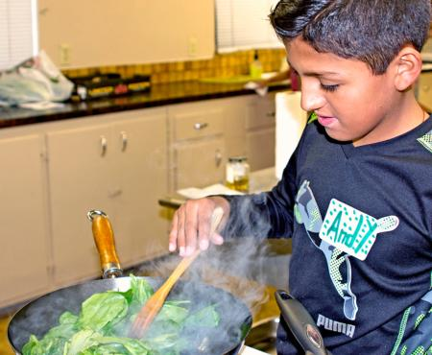
Develop Marketing Materials & Dissemination

Slide 50
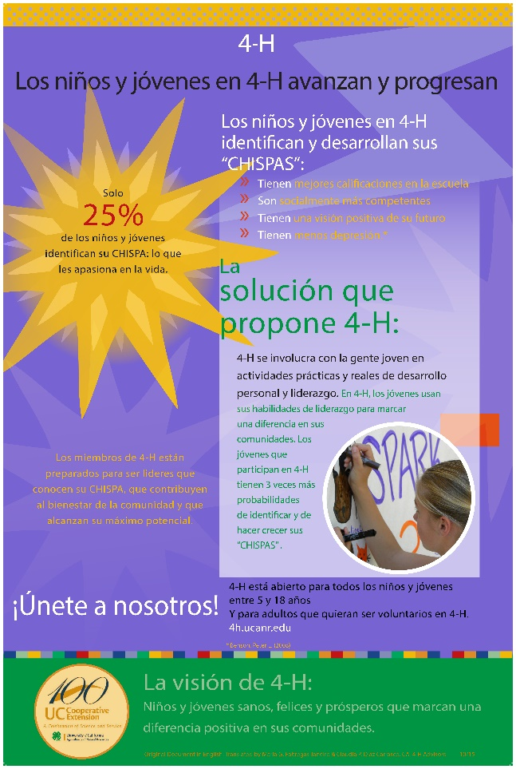
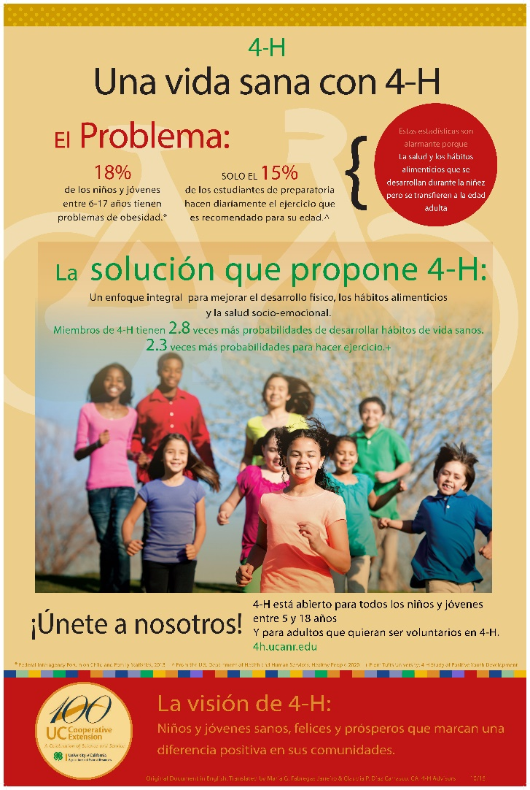
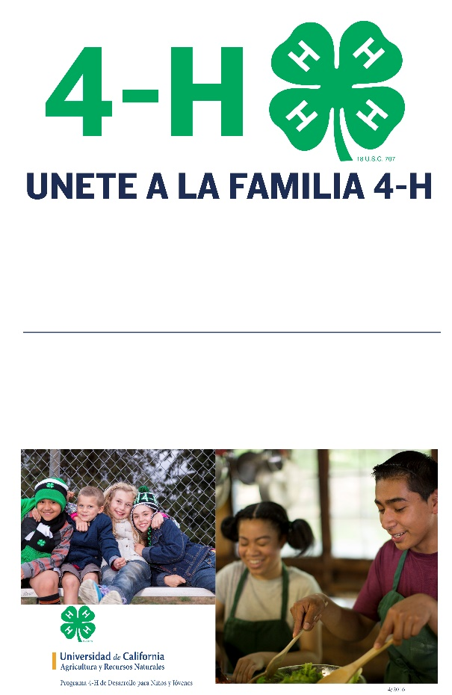
Bilingual Marketing Materials

Slide 51
Becoming National Leaders
National 4-H Programs Serving Latino Youth
Soule, K., Schmitt-McQuitty, L., Mariscal, D., University of California, Agriculture & Natural Resources, Diversity Workgroup & 4-H Council Latino Advisory Committee
Contribute to the 4-H National Council Latino Youth Outreach – Best Practices Toolkit

Slide 52


Social Media
73% @CaliforniaPrograma4H
34% @ca4H
25% @California4H
Source: Pew Research Center, Internet Project September combined Omnibus Survey, Sept. 11-14, 2014 and Sept. 18-21, 2014.
Notes:
68% of Latinos who use the internet use social media.
Most are on Facebook – 73%. That is why we created a Spanish Facebook page - @CaliforniaProgram4H
We try to post in Spanish, with English following. This is a recommendation from the Latino Outreach Office in Riverside, who handle the Spanish media outreach.
We are also using our other social media outlets – Instagram and Twitter – to post in both English & Spanish on the same account. Most of our content on these channels is in English, but on occasion we post in Spanish.

Slide 53
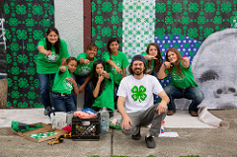
Bilingual presentations
4-H, Formando líderes /
4-H, Developing leaders

Slide 54
What is next?

Slide 55
1. Set a GOAL
Move at least to the acceptance level of the continuum

Slide 56
2. Identify where YOU are

Slide 57
IDI Orientations
Denial
We do not need to change anything.
I hugged a colleague at work from a different culture, and it felt awkward.
Have visited Europe and Mexico a couple of times. I can handle cultural differences.

Slide 58
Denial
I have been working with the public for 20+ years, there’s no big differences
The area I work in, is not very culturally diverse
I don't think I have challenges regarding culture with coworkers. I think getting to know all my coworkers is a challenge and that is not impacted by culture in my opinion

Slide 59
Polarization
They are not part of the group, they are what they are and I am who I am
I can relate to another culture just knowing what is right and wrong
They have a Superiority complex. Historically the other culture has always felt superior
I am always nice to them
My culture is the best in the word, I never going to be like them.

Slide 60
Minimization
We have a lot of things in common (more than I imagined)
I am glad I do not have to make a lot of effort to fit in! We are the same!!!!!
I have the opportunity to interact with people from other cultures and I am finding out that we have a lot of things in common
I do not understand what the big deal is, dealing with different cultures is not that hard. We share so many things
I lived in a melting pot growing up
My team and I work well together, cultural differences don't affect our responsibilities.

Slide 61
Minimization
Treat everyone with respect no matter their culture. Reach out to other cultures to address the needs of families
Helping others with negative remarks on other cultural to see the positive and acknowledge good in the cultural
Treat all people fairly and as equal as possible given individual circumstances
Treat everyone with respect no matter their culture. Reach out to other cultures to address the needs of families

Slide 62
Acceptance & Adaptation
We are different but there is no right or wrong
I have partnerships in place that ensure we have program successes across all cultures. Planning is a key component
In my husband's culture, eating, greeting, and passing objects with the left hand is seen as disrespectful. My husband and I had productive conversation surrounding the cultural significance of this belief/viewpoint, and after the discussion I shared a greater understanding and respect for this cultural difference
It is hard understanding each other clearly due to language barriers or different social norms. I know we are different but I am trying

Slide 63
Acceptance & Adaptation
I have always enjoyed learning about other cultures
Taking a moment prior to and remind myself of the differences in the cultures
That trust be present in the relationships That people of different cultures have their contributions to discussion heard and understood
I think its best to focus on making sure everyone understands and is comfortable in resolving differences.
Reaching all cultures who qualify for program opportunities and adapting lessons and information to the cultural needs within the context of resources in the state

Slide 64
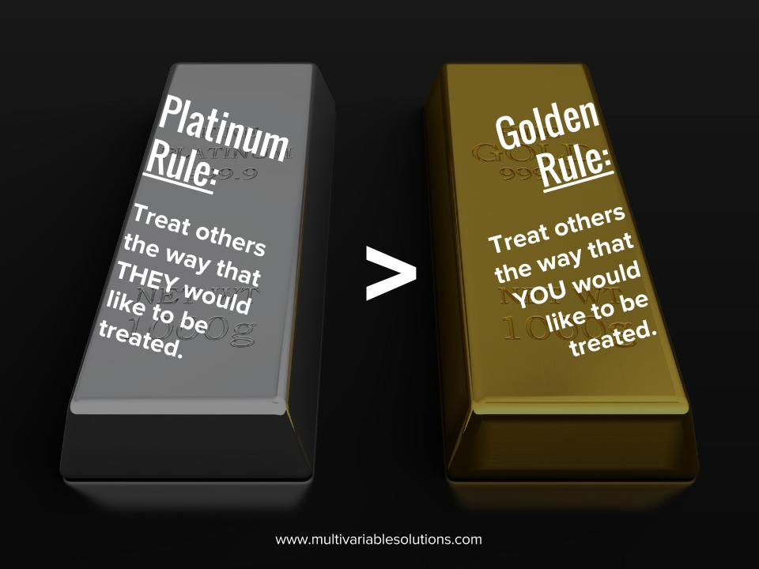
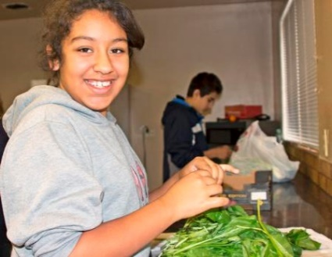
Follow The Platinum Rule
Notes:
Many people have grown up learning about the simplicity and power of the Golden Rule: Do unto others as you would want done to you. It's a splendid concept except for one thing:
Everyone is different, and the truth is that in many cases what you'd want done to you is different from what others would want done to them.
The Platinum Rule states: Do unto others as they would want done to them. By shifting the focus from oneself to the person of their focus, something powerful happens.
“The Golden Rule, as great as it is, has limitations, since all people and all situations are different. When you follow the Platinum Rule, however, you can be sure you're actually doing what the other person wants done and assure yourself of a better outcome.“
Dave Kerpen, The Art of People
Let’s briefly look at 4 ways that one could discover how someone else wants to be treated.

Slide 65

So….what is NEXT?
Where should we start?

Slide 66

Lupita’s Rules to Build an Intercultural Competent Community

Slide 67


Rule # 1
Be Honest with yourself.

Slide 68
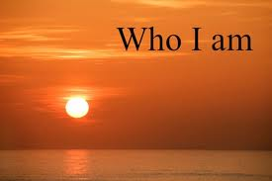


Rule # 2
Learn about your own culture

Slide 69
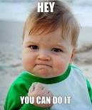
Rule # 3
Understand that dealing with different people is not natural and requires effort

Slide 70
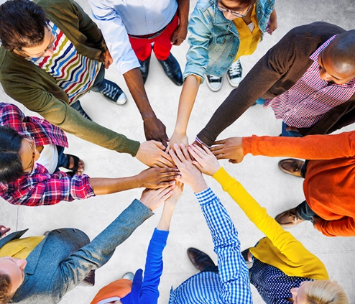
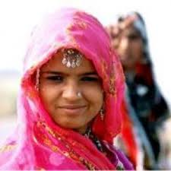

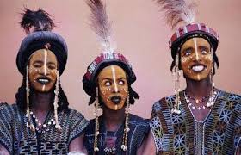
Rule # 4
Show sincere interest and respect for other cultures.

Slide 71

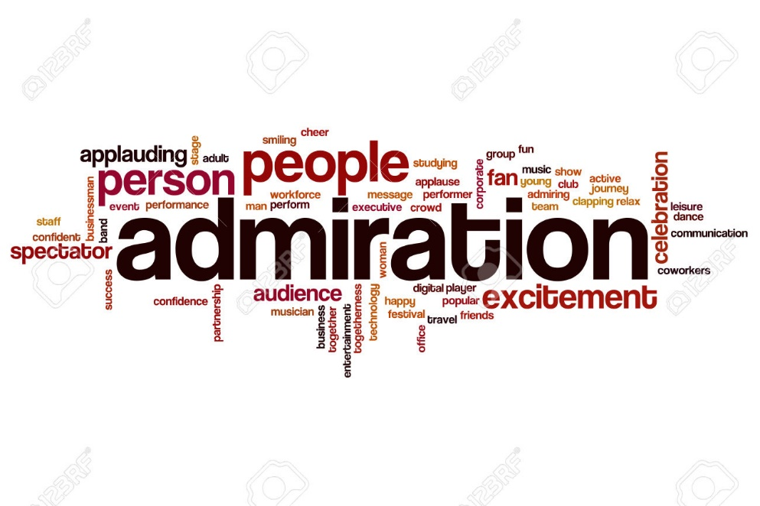
Rule # 5
Find things that you
admire from other cultures.

Slide 72
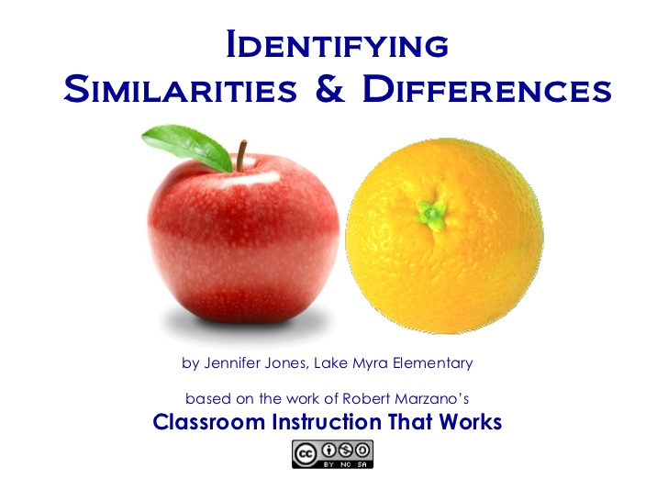
Rule # 6
Identify differences & commonalities between your culture and other cultures.

Slide 73

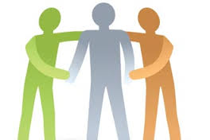
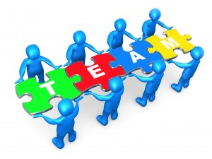
Rule # 7
Attend trainings and organize/lead Communities of Practice where you can talk about
Intercultural Competence
BE PROACTIVE!!!
Notes:
Beyond stereotypes…How can we learn to work with people from other cultures?
Be aware of your own culture. Learn about your culture, what do we like, how do we work, what is my perception of the time….
If you need to work with people from other cultures
2. Show sincere interest in other cultures, try to learn a couple of sentences, you will be surprise about the power of your words.
Read about other cultures, geography – history, it is terrible when somebody mention something like “where is your country at”….i thought your country was in Africa….. Why do you speak English if your country is in Asia?
Identify the most important differences between your culture and your coworkers or employees culture. Are more relax than you are?, Do they talk too much? Do they like to get to close?
Accept the differences. You won’t change them….but in the work place….for your workers own safety, you MUST have very clear working rules. Wear gloves, safety glasses, talk in English, arrive on time.
Adapt and modify your behavior as a sign of respect……BOTH ways…. your workers and you… you do not have to do all the work. They are on time, you give them the holidays! Win-Win situation

Slide 74
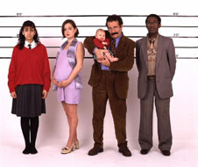
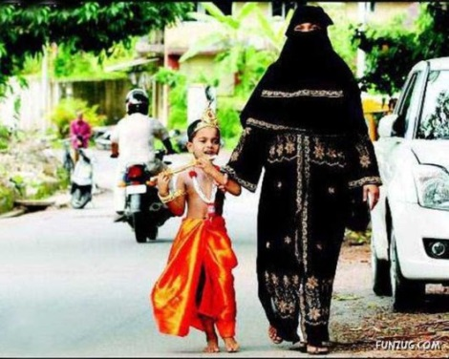

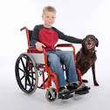
Rule # 8
Be aware and appreciative all that diversity can
bring to your institution
(not just talk the talk… but walk the walk)

Slide 75
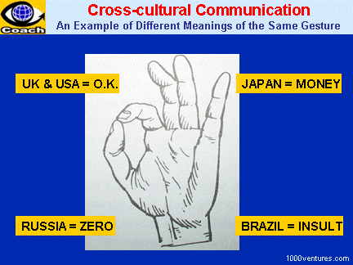
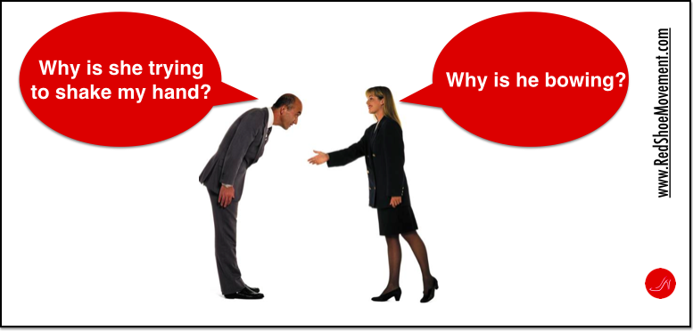
Rule # 9
Learn to accept and respect cultural differences.
“Understanding differences and having my differences be understood” Tennessee FCS Educator

Slide 76
Rule # 10
Always
remember…..

Slide 77
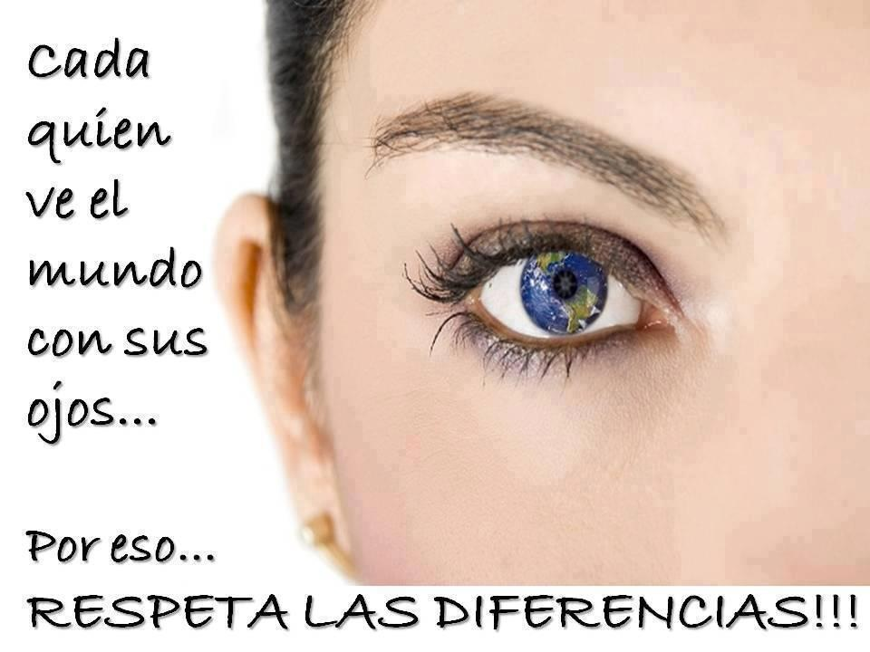
Each one of us...sees the world with different eyes
That is why…We need to respect the Differences!

Slide 78
Expected Outcome
Discuss key concepts related to Multicultural Environments, Diversity, Inclusion & Intercultural Competence
Discuss the University of UC ANR Diversity & Inclusion Model
Gain understanding on how to develop a plan to improve your organization and personal Intercultural Competence

Slide 79
Questions?

Slide 80
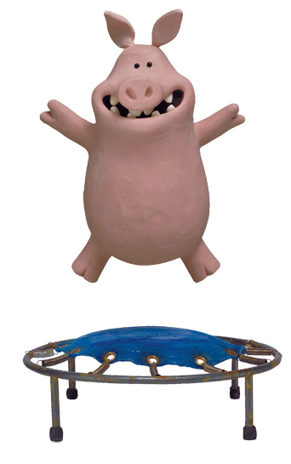
Gracias
Thank You
Merci
Danke
धन्यवाद
Gracies
Obrigado
ขอบคุณ
Ekusheh
Salamat

Slide 81
References
Bennett, M. J. (1986). A developmental approach to training for intercultural sensitivity. International Journal of Intercultural Relations, 10, 179-195.
Bennett, M. J. (1993). Towards ethnorelativism: A developmental model of intercultural sensitivity. In R. M. Paige (Ed.), Education for the intercultural experience (pp. 21-71). Yarmouth, ME: Intercultural Press.
Berthoin, A.& Friedman, V. J. (Writer) (2008). Learning To Negotiate Reality: a Strategy for
Teaching Intercultural Competencies
Cross Cultural Communication. Retrieved October 14, 2013, from http://www.google.com/imgres?imgurl=http://bestcareermatch.com/files/2013/06/white-triangle.gif&imgrefurl=http://bestcareermatch.com/cross-cultural-communication/&h=509&w=720&sz=72&tbnid=gzyAdkc8ilrPLM:&tbnh=117&tbnw=166&zoom=1&usg=__gQWLTO3KQUt2M8nO6NUndhfFRI=&docid=2LSGoCl12rSs1M&sa=X&ei=0gdgUuDPDcrm2gXO8IGgDg&ved=0CDMQ9QEwAA
Haeger, L. C. (2007). Intercultural competence: An investigation of strategies employed by
transnational faculty members. Unpublished Ph.D., Capella University, United States -- Minnesota.
Hammer, M. R., Bennett, M. J., & Wiseman, R. (2003). Measuring intercultural sensitivity: The intercultural development inventory. International Journal of Intercultural Relations,27(4), 421-465.
Iowa State University. College of Liberal Arts. Diversity. Retrieved May 15th, 2009,
from http://www.las.iastate.edu/diversity.index.shtm1
Moran, R. T., Harris, P. R. & Moran, S. V. (2007). Managing cultural differences: Global leadership strategies for the 21st Century. (8th Ed.). Burlington, MA: Butterworth-Heinemann.
Peterson, B. (2004). Cultural intelligence. A guide to working with people from other cultures. Yarmounth, Main: Intercultural Press.
Talent Retention and the International Assignment. Retrieved October 7th, 2013, from www.spe.org/publications/tt/documents/v1n4_hr_perspective.pdf
Zhu, Y. (2001). Using a knowledge-based approach to develop student intercultural competence
in industry. Business Communication Quarterly, 64(3), 102.

